Slide 1
Introduction to ADO Entity Framework
ir Denis VOITURON
http://www.dvoituron.be
Source: http://blogs.microsoft.co.il/blogs/gilf

Slide 2
Agenda
Entity Framework Introduction
Exploring the Entity Data Model
Querying and Manipulating Entity Data Models
Summary

Slide 3
The story so far…
The “Impedance Mismatch”
Conceptual / Business Model (Objects)
Relational Database

Slide 4
Solution - Entity Framework
Data access framework
Supports data-centric applications and services
Enables programming against a conceptual application model
Enables independency of any data storage engine or relational schema

Slide 5
Programming Against a Model
EF uses a model called an Entity Data Model (EDM)
EDM is a client-side data model
EDM is an abstraction layer on top of the data storage
Remove the pain of
Interacting with the data storage
Translating the data into objects

Slide 6
DEMO
EF First Glimpse
Notes:
Create a new WPF project
Add a new Item "ADO.NET Entity Data Model"
Connect to a SQL Server Database (ex. DataSource="tcp:AL-XPPROEN\SQLEXPRESS, 1433", Initial Catalog=Scott)
Select EMP & DEPT
using (Data.ScottEntities scott = new Data.ScottEntities())
{
Data.EMP emp = scott.EMPs.OrderByDescending(e => e.SAL).First();
MessageBox.Show(String.Format("{0} - {1}", emp.ENAME, emp.SAL));
}

Slide 7
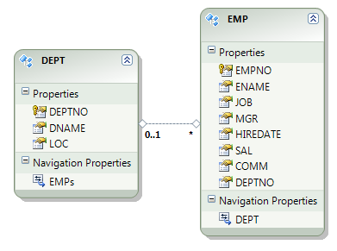
The Entity in "Entity Framework“
Items described in the EDM are called entities
Entities have only properties but no behavior
Entities can have relationships with other entities

Slide 8
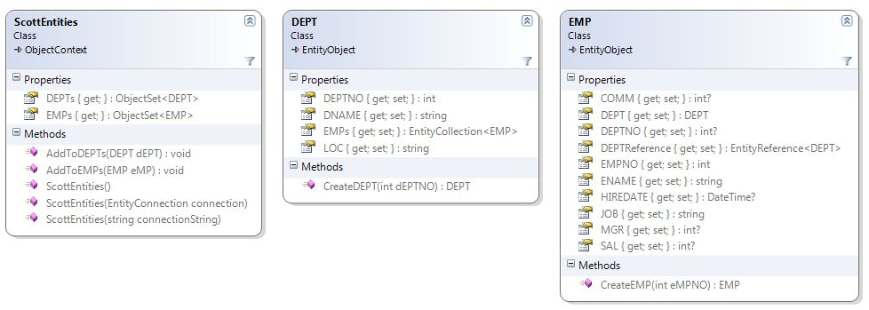
Entity Framework’s Entities

Slide 9
Entity Framework Backend
The model doesn't have any knowledge of the data storage
The backend data storage has no impact on your model or your code
Uses a provider model to interact with the data storage
Available providers:
SQL Server
Oracle
MySQL
Many more
http://msdn.microsoft.com/en-us/data/dd363565.aspx

Slide 10
Agenda
Entity Framework Introduction
Exploring the Entity Data Model
Querying and Manipulating Entity Data Models
Summary

Slide 11
The EDM Within the EF
Automatically generates classes from the model
Takes care of all of the database connectivity
Provides common query syntax for querying the model
Provides a mechanism for tracking changes to the model's objects

Slide 12
The EDM in the Designer Window
Designer Window:
Graphical representation of an EDM and its members
Enables adding more features to the model
Enables properties configuration
Enables updating from the data store
Enables model validation

Slide 13
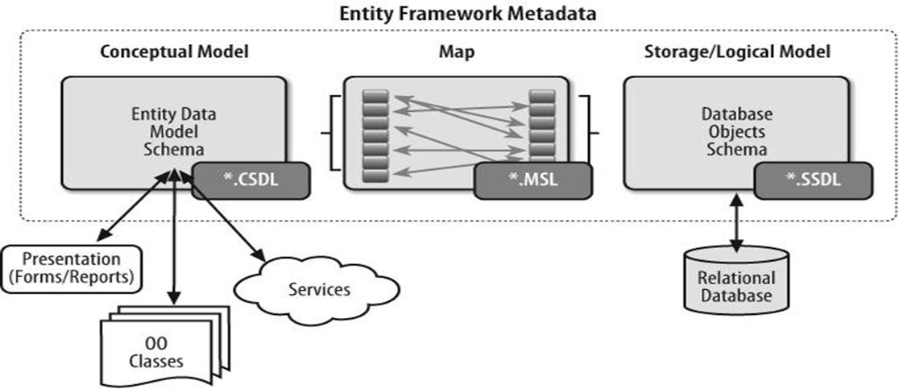
Exploring the Model's XML
The Three Parts of the Model:
The image is taken from Julia Lerman’s book Programming Entity Framework, 1st Edition

Slide 14
Exploring the Model's XML
<?xml version="1.0" encoding="utf-8"?>
<edmx:Edmx Version="2.0" xmlns:edmx="http://schemas.microsoft.com/ado/2008/10/edmx">
<!-- EF Runtime content -->
<edmx:Runtime>
<!-- SSDL content -->
<edmx:StorageModels> ... </edmx:StorageModels>
<!-- CSDL content -->
<edmx:ConceptualModels> ... </edmx:ConceptualModels>
<!-- C-S mapping content -->
<edmx:Mappings> ... </edmx:Mappings>
</edmx:Runtime>
<!-- EF Designer content (DO NOT EDIT MANUALLY BELOW HERE) -->
<Designer xmlns="http://schemas..."> ... </Designer>
</edmx:Edmx>

Slide 15
Code Generation – from EDM to Classes
EF automatically creates a set of classes from the model
You work with the model through the generated classes
Every change to the model can change the generated classes

Slide 16
Agenda
Entity Framework Introduction
Exploring the Entity Data Model
Querying and Manipulating Entity Data Models
Summary

Slide 17
Querying the Model
Queries are built against a data model
EDM query transform into data storage query
Query results materialize into model entities

Slide 18
Querying the Model
Objects
Linq to Entities
Entity SQL
DataReader
ObjectServices
Entity SQL
DataReader
Metadata files
EntityClient provider
CSDL
MSL
ADO.NET Data providers (e.g. SqlClient)
SSDL
Data Store

Slide 19
Query Options
Three kinds of queries in EF
LINQ to Entities
Entity SQL with Object Services
Entity SQL with Entity Client
Every kind has its pros and cons

Slide 20
LINQ to Entities Queries
Queries written in LINQ syntax
Support for LINQ features
Full IntelliSense support
var query = from emp in scott.EMPs
where emp.ENAME.StartsWith("S")
orderby emp.ENAME ascending
select new
{
Name = emp.ENAME,
Title = emp.JOB,
Salary = emp.SAL
};

Slide 21
Entity SQL Queries
T-SQL-like query language
Provide the necessary capabilities for querying the EDM
EF translates Entity SQL into storage-specific queries
var query = @"SELECT VALUE e
FROM ScottEntities.EMPs AS e
WHERE e.ENAME LIKE 'S%' ";
var employees = scott.CreateQuery<EMP>(query);

Slide 22
Entity Client Queries
Streams data back to the application
Resembles SqlClient, OracleClient and the other client providers
using (var conn = new EntityConnection("name=ScottEntities"))
{
conn.Open();
using (EntityCommand cmd = conn.CreateCommand())
{
cmd.CommandText = "SELECT VALUE d FROM ScottEntities.DEPTs AS d ";
using (EntityDataReader dr =
cmd.ExecuteReader(CommandBehavior.SequentialAccess))
{
while (dr.Read())
{
MessageBox.Show(dr.GetString(1));
}
}
}
}

Slide 23
Pros and Cons
Entity SQL with Entity Client | Entity SQL with Object Services | LINQ to Entities
 |  | ✓ | LINQ support
 |  | ✓ | IntelliSense
✓ | ✓ |  | Model dynamic queries
DbDataReader | Objects or DbDataRecords | Objects | Return type
✓ ✓ | ✓ ✓ ✓ | ✓ | Performance

Slide 24
Deciding which Query Method to Use
Choose Entity SQL with Entity Client
You want to return streamed data
You want to use EDM in existing applications
Choose Entity SQL with Object Services
You want to express queries that LINQ doesn’t enable
You want dynamic queries
You want the best performance
Otherwise choose LINQ to Entities

Slide 25
ObjectContext
How ObjectContext Manages Entities?
Every entity in ObjectContext has a ObjectStateEntry
ObjectContext uses ObjectStateEntries to track entity changes
using (ScottEntities scott = new ScottEntities())
{
if (scott.EMPs.First().EntityState == EntityState.Unchanged)
{
...
}
}

Slide 26
The SaveChanges Method
Persists back to the data storage all the changes made to entities
Uses the ObjectStateEntries to build the relevant data storage commands
Unit of work pattern
using (ScottEntities scott = new ScottEntities())
{
scott.SaveChanges();
}

Slide 27
Adding New Entities
Create entity in memory
Create in memory manually
Use the entity’s generated CreateObject method
Add entity
By Assignment to an existing entity’s property
By adding to a EntityCollection using AddObject method
Use ObjectContext .AddTo methods

Slide 28
Adding New Entities
Example:
using (ScottEntities scott = new ScottEntities())
{
DEPT dept = new DEPT();
dept.DEPTNO = 50;
dept.DNAME = "DotNet";
dept.LOC = "Gosselies";
EMP emp = scott.CreateObject<EMP>();
emp.EMPNO = 9999;
emp.ENAME = "Voituron";
emp.DEPT = dept;
scott.EMPs.AddObject(emp);
scott.SaveChanges();
}

Slide 29
Deleting Entities
Entity must be in hand in order to perform delete
Use the ObjectContext DeleteObject method
using (ScottEntities scott = new ScottEntities())
{
DEPT dept = scott.DEPTs.FirstOrDefault(d => d.DEPTNO == 50);
EMP emp = scott.EMPs.FirstOrDefault(e => e.EMPNO == 9999);
scott.DEPTs.DeleteObject(dept);
scott.EMPs.DeleteObject(emp);
scott.SaveChanges();
}

Slide 30
Customizing EDM
Business Entities
Entity Framework Layers
Entity
Entity
Entity
Conceptual
CSDL
Mapping
MSL
Table
Table
Table
Table
Logical
SSDL
Relational Data

Slide 31
Agenda
Entity Framework Introduction
Exploring the Entity Data Model
Querying and Manipulating Entity Data Models
Summary

Slide 32
Summary
Entity Framework brings massive changes to data access area
We only scratched the surface
Entity Framework
Data access framework
Supports data-centric applications and services
Enables programming against a conceptual application model
Has many features to be discovered

Slide 33
Resources
Slides and WebCast
http://www.dvoituron.be
Slides inspired from Gil Fink
http://blogs.microsoft.co.il/blogs/gilf
ADO.NET Team Blog
http://blogs.msdn.com/adonet
Data Developer Center:
http://msdn.microsoft.com/data

